Slide 1





Modules and Routing
SPA Overview
Modules
and
Routing
SoftUni Team
Technical Trainers
Software University
http://softuni.bg

Slide 2

Table of Contents
The NgModule
  Creating your own modules
Routing Overview
Router Module
Router Guards

Slide 3
Have a Question?
sli.do
#js-web

Slide 4

The NgModule
Creating your own modules

Slide 5
Angular Modules Overview
NgModules help organize an application into cohesive blocks of functionality.
An NgModule is a class decorated with @NgModule
Many Angular libraries are NgModules
  FormsModule, HttpClientModule, RouterModule
Many third-party libraries are available as NgModules
  Material Design, Ionic, Angular Fire
import { NgModule } from '@angular/core';

Slide 6
Creating Custom Modules
Creating you own modules is useful when the application grows
Only the root module should contain BrowserModule
All custom made modules should import CommonModule
Custom made modules have exports array
  Components added in declarations are private by default
  This is done because of reusability.
import { CommonModule } from '@angular/common';

Slide 7
Creating Cutom Modules (2)
import { NgModule } from '@angular/core';
import { CommonModule } from '@angular/common';
@NgModule({
  imports: [ CommonModule ],
  declarations: [ CustomerCreateComponent, CustomerListComponent,
  CustomerDetailsComponent],
  exports: [ CustomerListComponent ],
  providers: [ CustomersService ]
})
export class CustomersModule {}
Export the component in order to render it outside this module

Slide 8
Suggested Common Module
Shared Module - to contain all common components, directives and pipes used by a lot of places
Core Module – to contain singleton services and components needed only once in the application
  Authentication Module (Register, Login, Logout)
Feature Module – to contain feature specific components
More info: https://angular.io/guide/ngmodule

Slide 9
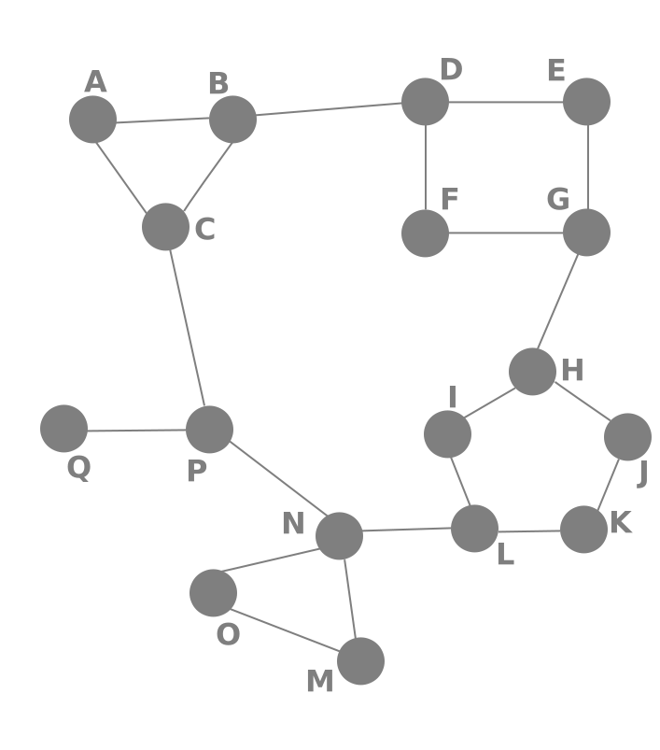
Routing Overview
Navigation for Single Page Apps

Slide 10


What is Routing?
Routing allows navigation, without reloading the page
It's a pivotal element of writing Single Page Applications
Link
HTML
Router
Link
Link
Link
Standard Navigation
Navigation using Routing

Slide 11

Single Page Applications
A Router loads the appropriate content when the location changes
  E.g. when the user manually enters an address
Conversely, a change in content is reflected in the address bar
  E.g. when the user clicks on a link
Benefits:
  Load all scripts only once
  Maintain state across multiple pages
  Browser history can be used
  Build User Interfaces that react quickly

Slide 12

Router Module
Basic Routing in Angular

Slide 13
Define the Template
First add the base meta tag into the index.html file
Add a nav tag so the user can navigate through the app
Define the router outlet where the content will be rendered
<base href="/">
Usually added by the CLI
<nav>
<a routerLink="/home">Home</a>
<a routerLink="/about">About</a>
</nav>
<router-outlet></router-outlet>

Slide 14
Create Routes Module
Import NgModule, RouterModule and Routes
Define the needed routes as an array of objects
import { NgModule } from '@angular/core'
import { RouterModule, Routes } from '@angular/router';
const routes: Routes = [
{ path: 'home', component: HomeComponent },
{ path: 'about', component: AboutComponent } ]
'/' not needed infront!

Slide 15
Create Routes Module (2)
Define the App Routes Module using the decorator
@NgModule({
declarations: [
HomeComponent,
AboutComponent
],
imports: [RouterModule.forRoot(routes)],
exports: [RouterModule]
})
export class AppRoutesModule { }
Registers all app routes (done only once)

Slide 16
Create Routes Module (3)
Finally import the routes module in app module
import { AppRoutesModule} from './routes.module.ts'
// Other imports for core module
@NgModule({
declarations: [ AppComponent ],
imports: [
BrowserModule,
AppRoutesModule,
],
export class AppModule { }

Slide 17
Redirecting From a Path
Sometimes it is useful to redirect to a specific path
  For example the default route should redirect to home
const routes: Routes = [
{ path: 'home', component: HomeComponent },
{ path: '', redirectTo: 'home', pathMatch: 'full'}
{ path: 'about', component: AboutComponent } ]
The placement order of the routes matters!

Slide 18



Using Wildcards
If the requested URL doesn't match any paths for routes, show a 404 Not Found Page
  This is done by using a wildcard '**'
{ path: '**', component: PageNotFoundComponent }

Slide 19
Route Parameters
To take a parameter from the url:
After that inject Activated Route in the Component and extract the id
{ path: 'courses/:id',component: CourseDetailsComponent }
export class CoursesComponent {
public paramsId : string;
constructor(
private route : ActivatedRoute
) { this.paramsId = this.route.snapshot.params['id']; } }

Slide 20

Guards
Creating Simple Guards

Slide 21
Guards Overview
Limiting access to a route is needed in most applications (limit anonymous users for example).
In Angular there are route guards:
  Build a guard service
  Register the service in an Angular module
  Add the guard to a desired route

Slide 22
CanActivate Guard
The can activate guard checks criteria before activating a route
It limits route access to specific users (register users, admins..)
Ensure prerequisites are met (the user is logged)
Called when the url changes
import { Injectable } from "@angular/core";
import {
  Router, CanActivate,
  ActivatedRouteSnapshot,
  RouterStateSnapshot
} from "@angular/router";

Slide 23
Guard Example
Create a guard that limits non-authenticated users:
@Injectable()
export class AuthGuard implements CanActivate {
  canActivate(route: ActivatedRouteSnapshot, state: RouterStateSnapshot) : boolean {
  return this.checkIfLogged(state.url);
  }
  checkIfLogged(url : string) : boolean {
  // Use the authentication service
  }
}}

Slide 24
Router Additional Functionality
Children routes
Secondary routes
Lazy Loading and more: https://angular.io/guide/router
children: [ { path: '/create', component: CreateComponent } ]

Slide 25

Summary
NgModules help organize an application
Routing allows navigation without reloading the page
The Router Module in Angular is a powerful tool
  It supports basic routing, routing with parameters, child routes, route guards and more
import { NgModule } from '@angular/core'

Slide 26












Course Introduction
https://softuni.bg/courses/

Slide 27
License
This course (slides, examples, demos, videos, homework, etc.)
is licensed under the "Creative Commons Attribution-NonCommercial-ShareAlike 4.0 International" license
Attribution: this work may contain portions from
  "End-to-end JavaScript Applications" course by Telerik Academy under CC-BY-NC-SA license

Slide 28





Trainings @ Software University (SoftUni)
Software University – High-Quality Education, Profession and Job for Software Developers
  softuni.bg
Software University Foundation
  http://softuni.foundation/
  Software University @ Facebook
  facebook.com/SoftwareUniversity
  Software University Forums
    forum.softuni.bg

